Slide 1

Entrepreneur
Data is related to startup investments of THE USA
This data has contains 11 file with different schemas

Slide 2
About data
The startup world is flourishing. There are hundreds of new companies being founded each day and venture capital has become a substantial asset class with yearly investments exceeding $100B in the US alone. Crunchbase 2013 Snapshot © 2013 dataset provides a glimpse into this exciting world.
Content
This diverse dataset contains information about the startup ecosystem: organizations, individuals, company news, funding rounds, acquisitions, and IPOs.
There are 11 tables that can be joined using unique IDs (schema to follow). More information about the individual data variables can be found on the DATA website (under the API Entities Types section).
No extensive data quality check have been performed yet. The information is available up to December 2013.
While Kaggle contains other datasets focused on startup investments, to the best of my knowledge, this dataset has not yet been published on the platform and is unique.

Slide 3
Schema’s
Acquisitions
Acquisitions
Id
Acquisition _id
Acquiring _object _id (FK) Objects.id
Acquired _object _id (FK) Objects.id
Term _ code
Price _ amount
Price _currency _ code
Acquired _ at
Offices
Id
Object _id (FK) Objects.id
Office _id
Description
Region
Address1
Address2
City
Zip _code
Country _code
Objects
Country _code
State _code
City
Region
First _investment _at
Last _investment _at
Investment _ rounds
Invested _ companies
First _funding _at
Last _funding _at
Funding _round s
Funding _total_ USD
First _milestone _at
Last_ milestone _at
Milestones _ relationship

Slide 4
Degrees
Id
Object _ id (FK) Objects.id
Degree _ type
Subject
Institution
Graduated _ at
Created _ at
Updated _ at
Funds
Id
fund_ id
Object_ id (FK) → Objects.id
Name
Funded _ at
Raised _ amount
Raised _currency _ code
IPOs
Id
Ipo _ id
Object _ id (FK) Objects.id
Valuation _ amount
Valuation _ currency_ code
Raised _ amount
Raised _ currency_ code
Public _ at
Stock _ symbol
Investments-
id
Funding _ round_ id (FK)
Funding Rounds.id
Funded _object _ id (FK) Objects.id
Investor _object _ id (FK) Objects.id
Milestones-
Id
Object _id (FK) Objects.id
Milestone _ at
Milestone _ code
description
People-
Id
Object _id (FK)
Objects.id
First _ name
Last _ name
Birthplace
Affiliation _name

Slide 5
Relationships
Id
relationship_ id
Person _ object _id (FK) People. id
Relationship _object _id (FK)
Objects.id
Start _at
End _at
Is _past
Sequence
title
Funding Rounds-
id
Funding _round _ id
Object _id (FK) Objects.id
Funded _ at
Funding _round _ type
Funding _round_ code
Raised _ amount_ USD
Raised _ amount
Raised _ currency_ code
Pre _ money_ valuation_ USD
Pre _ money _valuation
Pre _ money _ currency_ code
Post _ money_ valuation_ USD
Post _ money_ valuation
Post _ money_ currency _ code

Slide 6
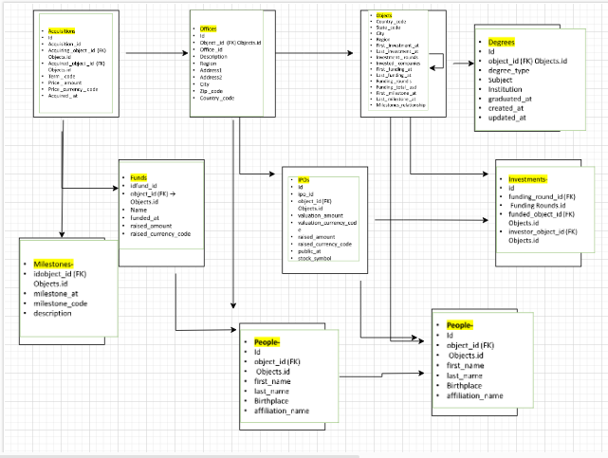
E-R Diagram

Slide 7
Technical-Tools for DATA ANALYSIS
ETL:- Talend open studio.
Excel:- cleaning the data.
MY-SQL :- Retreving the data and create the view.
Power bi:- data visualization and apply statistics.
Jupiter- notebook:-python(box-whiskers , standard-deviation).
MS–power pointer:- business analyst purpose .

Slide 8

PROCESS
ETL:- for access the file from client I have using Talend open studio
This is Etl (extract-transform-load) tool .
I am supposing that client sent csv file to Aws cloud to get the data from AWS-Cloud I am using Etl tool and load into My _ sql (database)

Slide 9
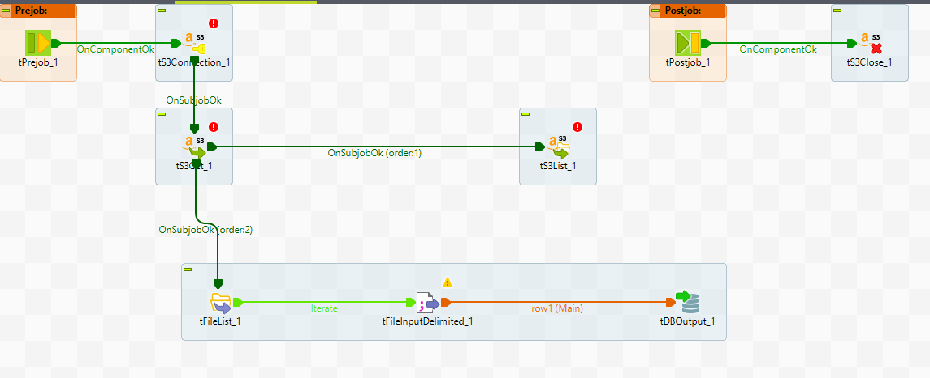
COMPONENT USED
AWS S3 CONNECTION
AWS CLOSED
AWS S3 GET
AWS S3 LOAD
DELIMITED-File input
T-file list
T-log-row

Slide 10
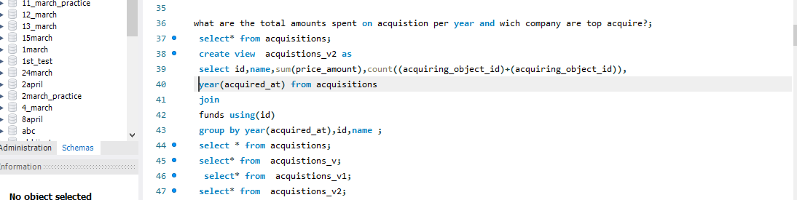
MY _ sql
After loading into my-SQL
Cross-check whether all data values are presented or not
Create some views on the basis of BUSINESS QUESTIONS
EX-
what are the total amounts spent on acquistions per year and which company are top acquire?
select* from acquisitions;
create view acquistions_v2 as select id,name,sum(price_amount),count((acquiring_object_id)+(acquiring_object_id)),year(acquired_at) from acquisitions join funds using(id) group by year(acquired_at),id,name ; select * from acquistions;
select* from acquistions_v;

Slide 11
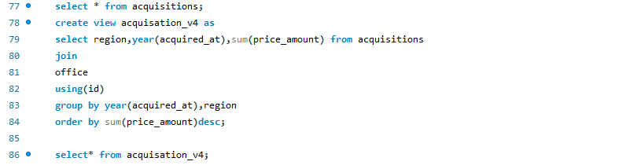
Which regions are receiving the most investments, and how has this changed over the past decade?
select * from acquisitions;
create view acquisation_v4 as select region, year(acquired_ at),sum(price _ amount) from acquisitions join office using(id) group by year(acquired _ at),region order by sum(price _ amount)desc;
select* from acquisation_v4;

Slide 12
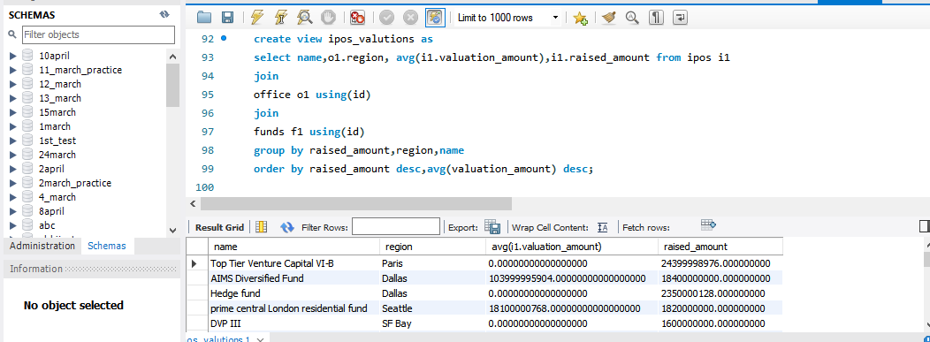

Slide 13
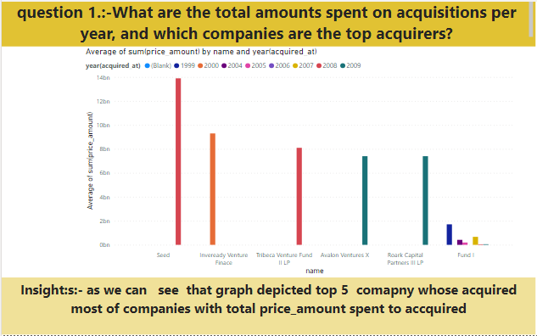
POWER_BI
FOR DATA ANALYSIS we are using power _ bi
There are some business questions

Slide 14
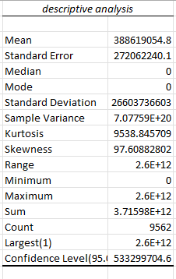
statistics

Slide 15
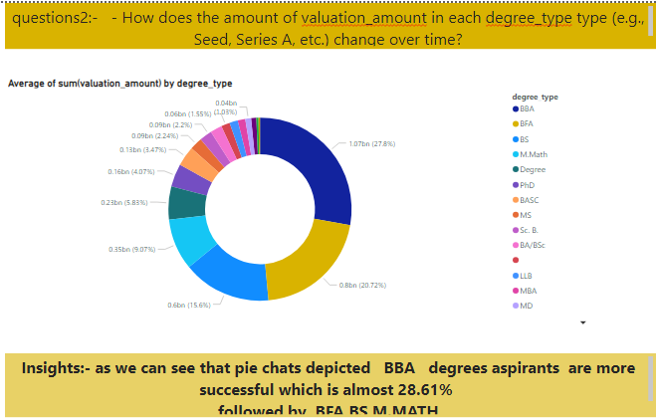
2nd analysis

Slide 16
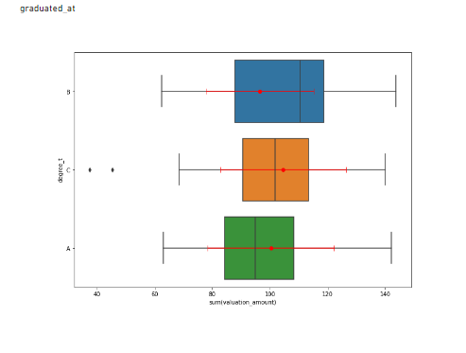
statistics

Slide 17
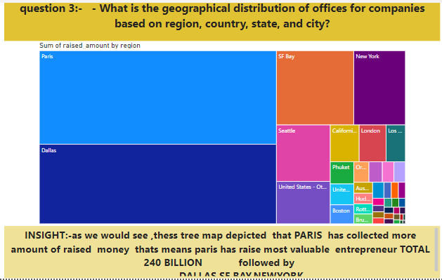
3.rd analysis

Slide 18
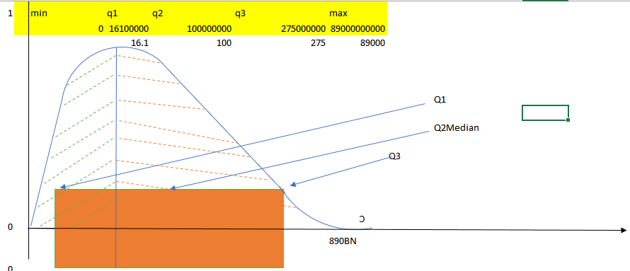
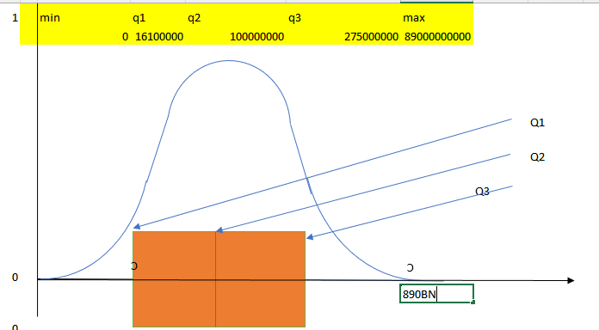
Standard deviation
This is
RIGHT-SKEWNESS
Graph
of total
Raised_amount

Slide 19
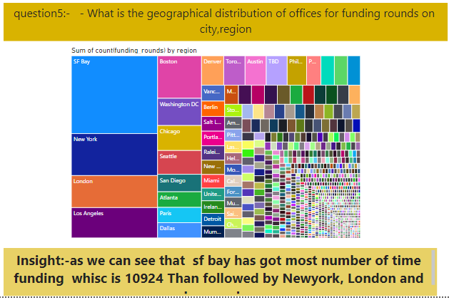
Question4:-

Slide 20
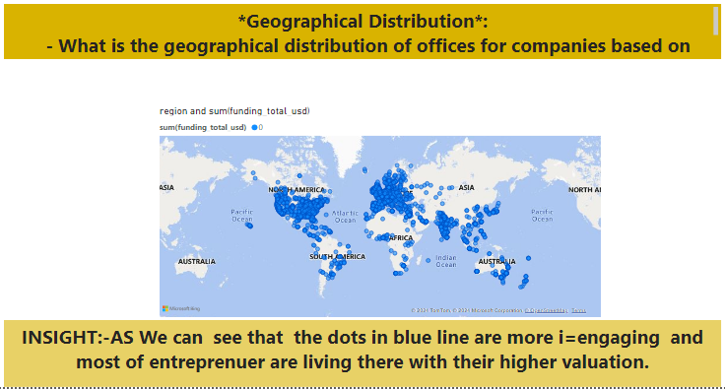
Geogrophical region

Slide 21
Statistics
~Normalisation graph for uniform distribution for region
1
USA
Africa

Slide 22
Insights:-
Acquiring companies by price _ amount:- Second Fund , Sequoia Israel Fourth Fund, Tenth fund are the top acquiring company over decade
Number of acquiring companies:-
Fund I | 62
Fund II | 49
Fund III | 38
Fund IV | 17
Fund VI | 14
Fund V | 10
Fund VII | 7
Second Fund | 6
Fund 1 | 6

Slide 23
Geographical Distribution:-
Basically we can say that most of area are covered by USA , Europe and India and some area of asia
Investors are likely to invest money in particular field
Eg:- Good government policy (like USA)
Having well- known Technology(like USA, Europe)
Cheap labour rate(like India and China)
India is most favourable as compare to china ?
Because India has cheap labour cost and having large population whose communicate in English ,China does n’t have this quality
Strict China policy and Pendemic hub IN CHINA (Corona-virus)

Slide 24
Degree Impact on Success:-
Well definetly
Education is important
BBA ,BFA,BS are top
Degrees and most of
CEO’S, Directors and
Higher authorities have
Graduate’s from above degrees
EXCEPTIONS:-
Ritesh Agrawal CEO of OYO and billioner is drop-out
MARK-ZUKERBURG OWNER OF FACEBOOk and worlds-9 richest men also
Drop out college
Alakh Pandey founder of PhysicsWala also drop-out

Slide 25
RECOMMADATION
For New Entrepreneur :-
New start-up has focus on “:- Second Fund , Sequoia Israel Fourth Fund, Tenth fund” for funding purpose.
Indian Stat-up got good response from Europe and USA funding-Firm.
Average funding raised _ amount is 400M USD dollar
For Old venture:-
Keeps eyes on milestone’s
Previous sales record and net growth

Slide 26
Thank-you

